Slide 1
About Fire Incidents
Harry He, Yang Sui, Jeff Zhang
In Big Data Era, Can we use Machine Learning to help improve our society?

Slide 2
Problem
Predict estimated damage from fire incident data

Slide 3
Motivation
Estimate damage quickly and cheaply
Gain insight into what factors lead to high dollar loss

Slide 4
Data
Toronto Fire Services
Quantified information on 12,000 fire incidents

Slide 5
Data Preparation

Slide 6
Feature Engineering

Slide 7
Feature Engineering
1. Download additional/accessory data
2. Visualize and investigate the data set
3. Converting important categorical features into binary columns
4. Delete unclassified/undetermined data
5. Examine the summarization/correlation of features
6. Re-examine the target variable and used manual tagging for classification modelling
6. Select sub-topics (reducing rows)

Slide 8
Download additional/accessory data
1. Fire hall location data
2. Canadian Census Dissemination Area (shape file)
3. Zoning by law
These information are used for the purpose of visualizing and understand the data better.

Slide 9
Visualize and investigate the data set
1. Fire hall location data
2. Canadian Census Dissemination Area (shape file)
3. Zoning by law
These information are used for the purpose of visualizing and understand the data better.

Slide 10
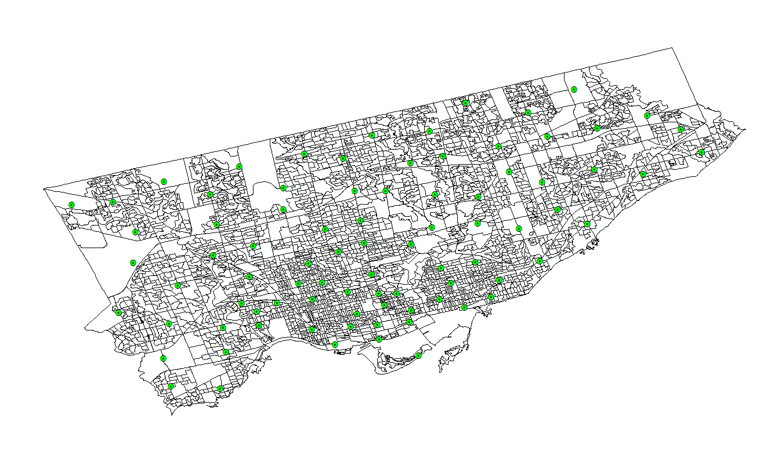

Slide 11
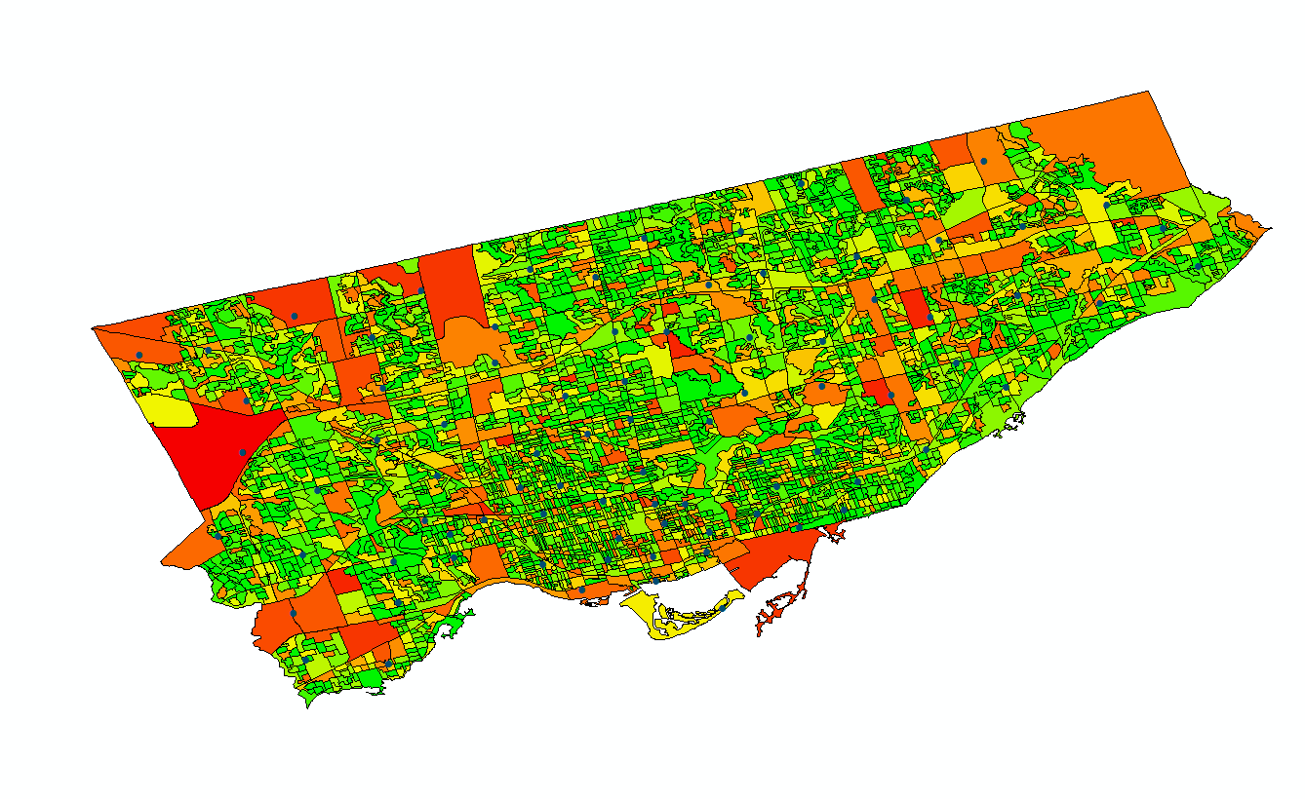

Slide 12
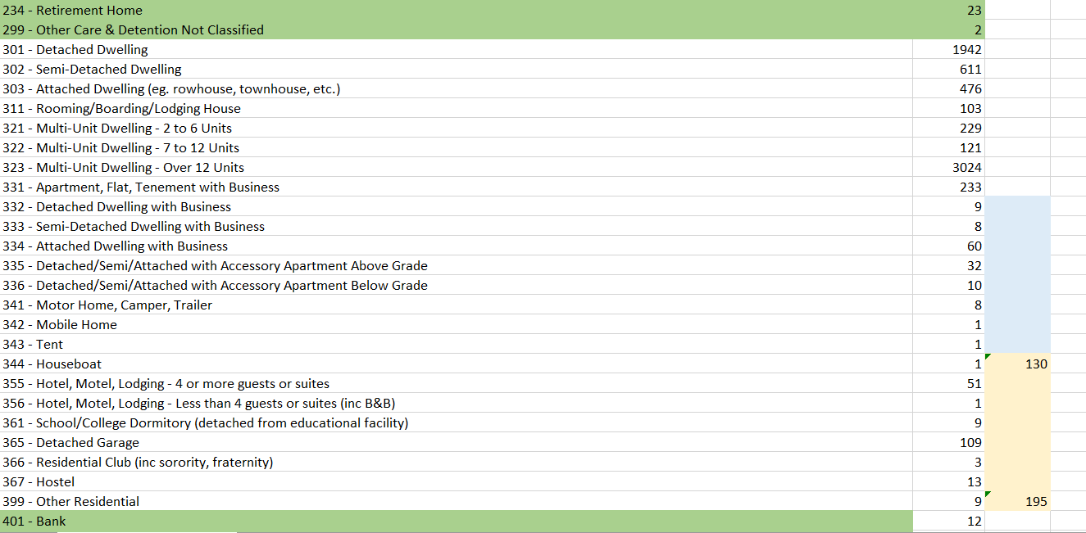
Visualize and investigate the data set

Slide 13
Converting important categorical features into binary columns
Extent of fire (same room, beyond room, etc)
Fire Alarm status (operational, people’s reaction etc)
Fire Control Method
Sprinkler System status
Smoke Alarm status
Property Usage ( public facilities, residential , automobiles, other, etc)
Material first ignited
Etc.

Slide 14
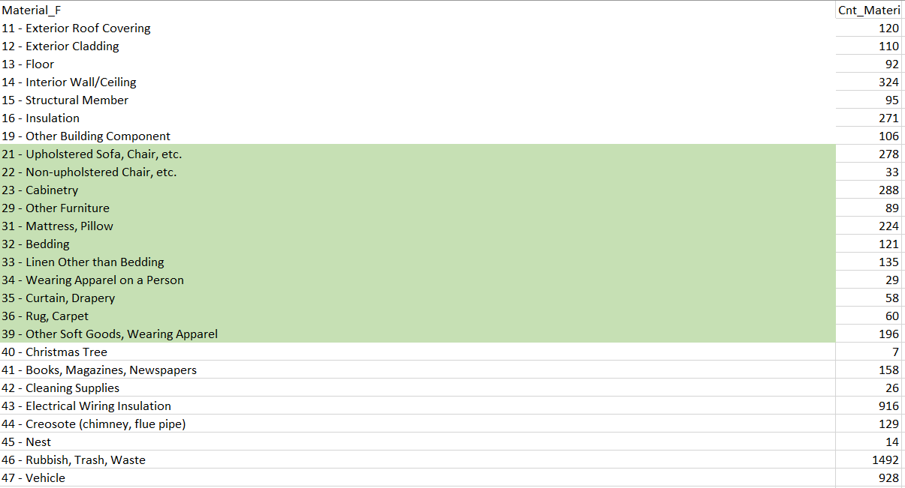
Converting important categorical features into binary columns

Slide 15
Converting important categorical features into binary columns
Engine response time
Fire under control time
Last unit clear time
These are some of the few numeric variables

Slide 16
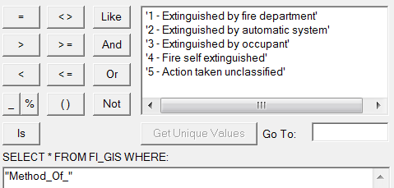
Delete unclassified/undetermined data

Slide 17
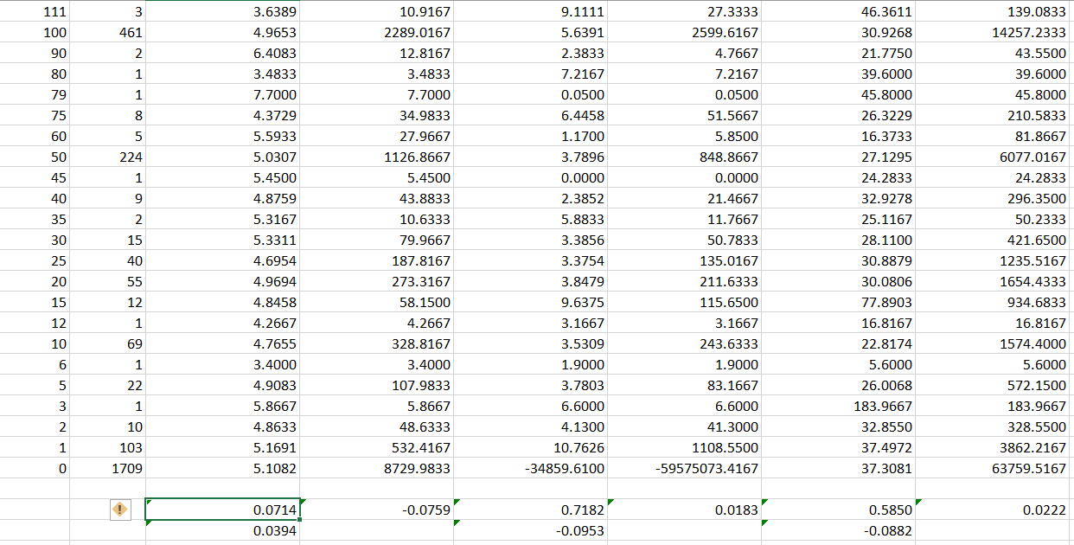
Examine the summarization/correlation of features

Slide 18
Regression
Numerical target variable: Estimated Dollar Loss
Tried number of models: - Linear Regression - Batch Gradient Descent - Stochastic Gradient Descent - SVM Regression

Slide 19
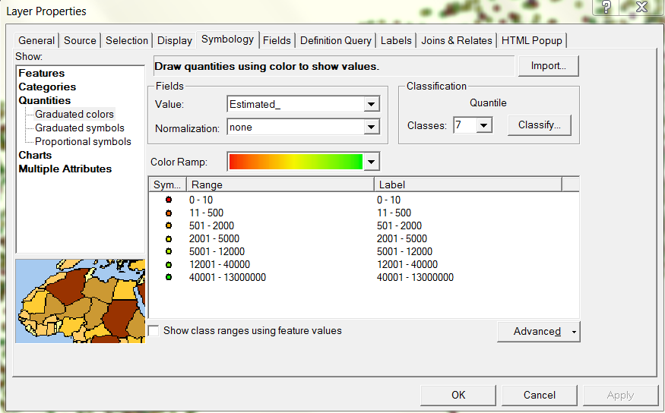
Re-examine the target variable and used manual tagging for classification modelling

Slide 20
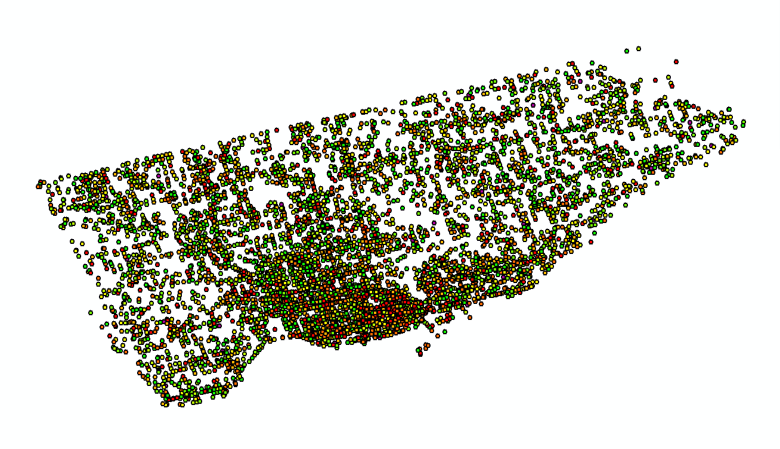
Re-examine the target variable and used manual tagging for classification modelling

Slide 21
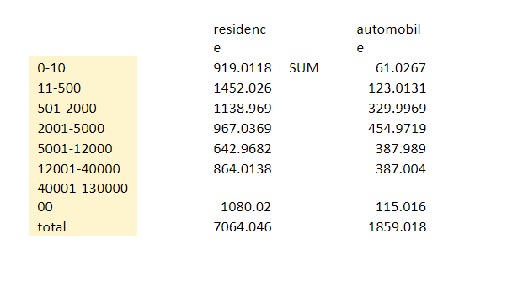
Re-examine the target variable and used manual tagging for classification modelling

Slide 22
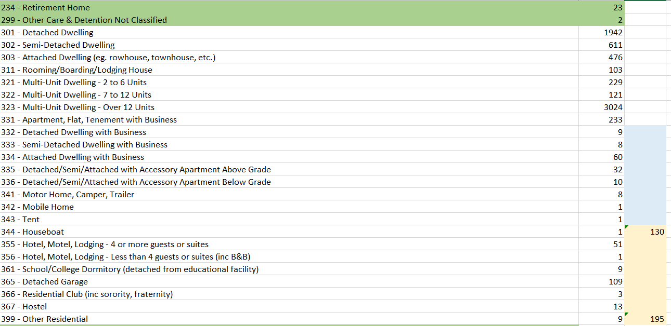
Select sub-topics (reducing rows)

Slide 23
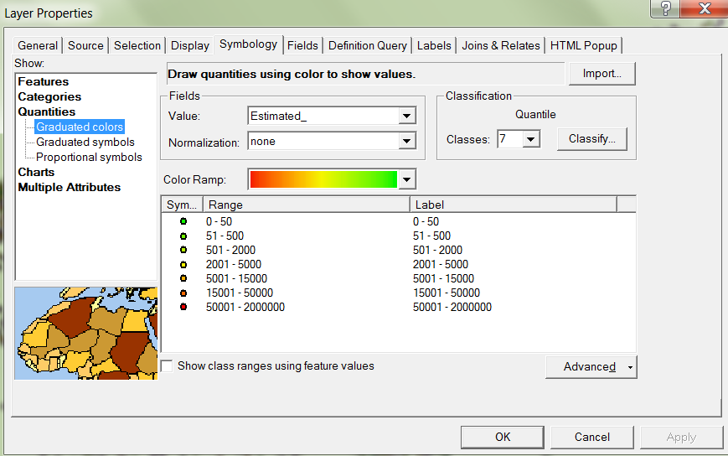
Select sub-topics (reducing rows)

Slide 24
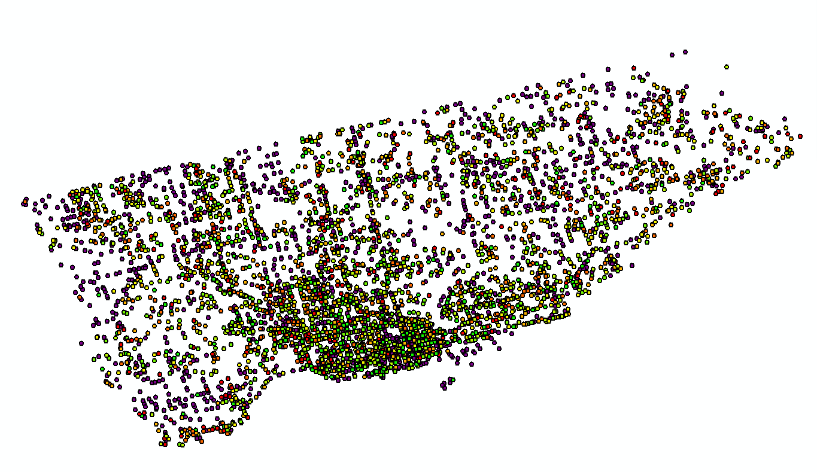
Select sub-topics (reducing rows)

Slide 25
Classification
Tried number of models:
-Pipeline - Logistic Regression - Decision Trees - Stochastic Gradient Descent - RandomForest
Maybe it will work?

Slide 26
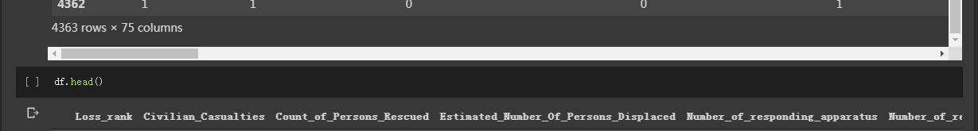
4363 Incidents, 75 Features.

Slide 27
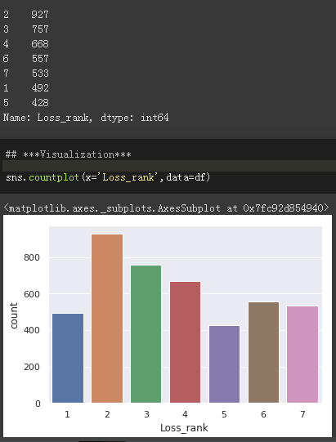

Slide 28
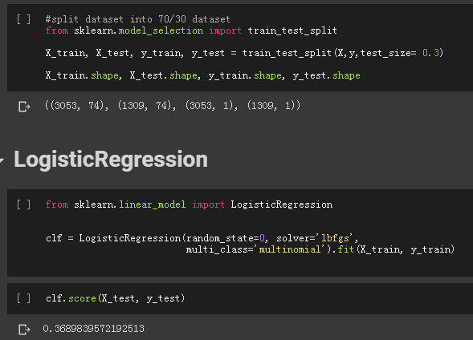
0.368

Slide 29
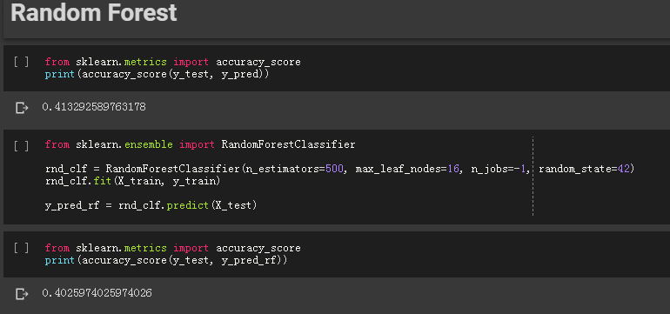

Slide 30
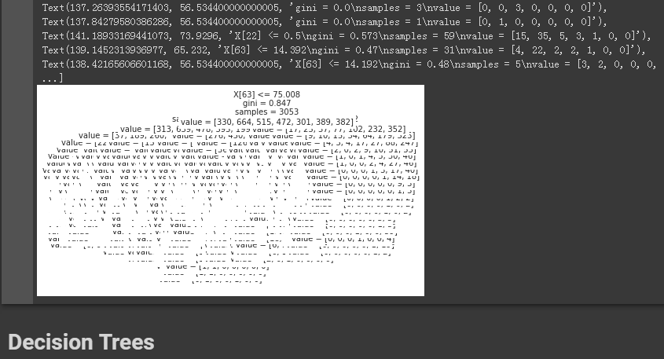

Slide 31
Conclusions
Work in progress
Learning experience
Need better exploration of data
Many areas to improve
Need much more practice

